Slide 1

CARBON
EMISSIONS
BDE (Big Data Energy)
Jack Craft - Project Manager
Jacqueline Kang - Researcher and analyst
Carl Mackensen - Subject Matter Expert
Noah Suskin - Administration and researcher
Notes:
Jack

Slide 2

01
03
TOPIC, HYPOTHESES
ANALYSIS, RESULTS
02
04
DATA
CONCLUSIONS
05
FUTURE WORK
Notes:
Jack → Carl

Slide 3
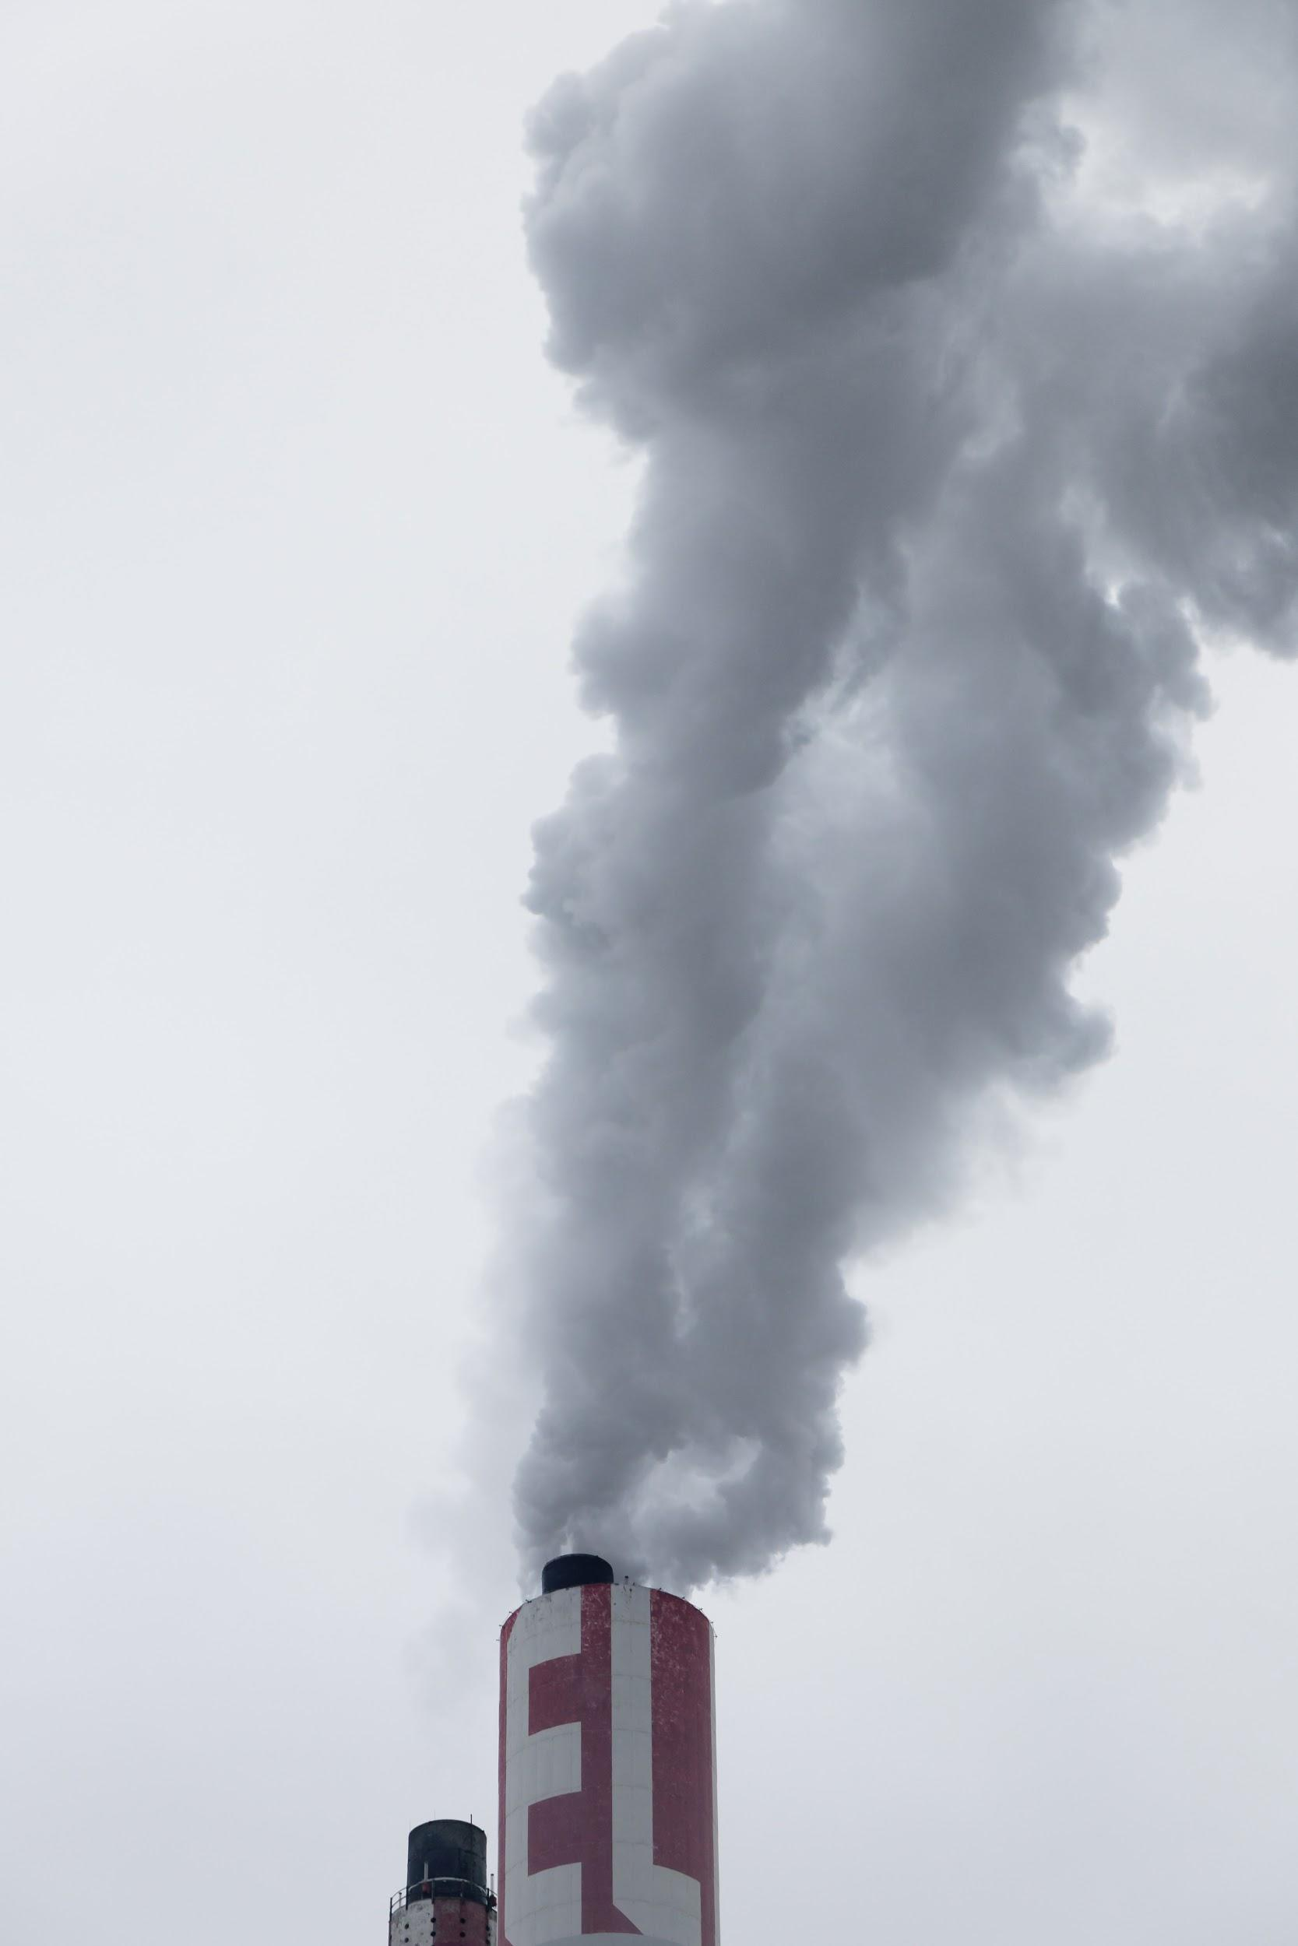
WHAT IS THIS TOPIC ABOUT?
WHAT IS THIS TOPIC ABOUT?
Look at how carbon emissions are affected by other attributes.
Salient and timely: carbon emissions & global warming are important issues moving forward.
Offers a good window into analytical tools by using a real world example.
Look at how emissions are affected by three things: a price on carbon, outdoor recreational space, and population.
Notes:
Carl

Slide 4

OBJECTIVE
OBJECTIVE
Targeting 3 core relationships, analyzed via regressions, & expecting negative relationships in all cases.
A price on carbon and emissions.
Outdoor spaces and emissions.
Population and emissions.
Notes:
Carl

Slide 5
OBJECTIVE
OBJECTIVE
Targeting 3 core relationships, analyzed via regressions, & expecting negative relationships in all cases.
A price on carbon and emissions.
Outdoor spaces and emissions.
Population and emissions.
Notes:
Carl

Slide 6
HYPOTHESES
3 HYPOTHESES
As the price of emitting carbon ↑, the amount of carbon emitted ↓
As the value of outdoor recreation activities ↑, the amount of carbon emitted per capita ↓
As population ↑, the amount of carbon emitted per capita ↓
Notes:
We have three testable hypotheses for the analytics we performed, which we sought to prove or disprove. They are:
As the price of emitting carbon increases, the amount of carbon emitted decreases.
As the value of outdoor recreation activities increase, the amount of carbon emitted per capita decreases.
As population increases, the amount of carbon emitted per capita decreases.

Slide 7
01
03
TOPIC, HYPOTHESES
ANALYSIS, RESULTS
02
04
DATA
CONCLUSIONS
05
FUTURE WORK

Slide 8
PRIMARY DATA SOURCES
DATA SOURCES
U.S. Energy Information Administration(EIA) :
U.S. emissions data; producer type, energy source, Co2, So2, NOx by states (1990-2018). (https://www.eia.gov/electricity/data.php#elecenv)
Regional Greenhouse Gas Initiative(RGGI) :
Carbon price data for RGGI states in the US; CT, DE, MA, MD, ME, NH, NJ, NY, RI, VT) from auction results (2008-2020). (https://www.rggi.org/auctions/auction-results)
California Carbon Dashboard :
Carbon price for CA 5-day moving average price and volume of California Carbon Allowance Futures (2011-2018). (https://calcarbondash.org/csv/output-csv.html)
Research Report :
The Social Cost of Carbon(SCC) for some states; CA, CO, IL, ME, MN, NY, WA (2008-2017).
(https://bloustein.rutgers.edu/wp-content/uploads/2018/05/2018-At-What-Cost-Final-Practicum-Report-May-2018.pdf)
Notes:
Jacqueline

Slide 9
THE OTHER DATA SOURCES
DATA SOURCES
Rutgers Data Science Bootcamp :
Population data (https://github.com/RutgersCodingBootcamp/RU-JER-DATA-PT-04-2020-U-C/blob/master/06-Python-APIs/3/Activities/09-Stu_Census/Solved/Census_States.ipynb)
Bureau of Economic Analysis(BEA) :
Income by states; personal income (2018, 2019), population(2019), per capita personal income (2019). (https://www.bea.gov/data/income-saving/personal-income-by-state)
Outdoor recreation by states; outdoor recreation value added, employment, compensation (2017).
(https://www.bea.gov/data/special-topics/outdoor-recreation)
Notes:
Jacqueline

Slide 10









DATA CLEANING & ASSEMBLY STEPS
DATA CLEANING & ASSEMBLY PROCESS
STEP 2
Review data and standardize file formats.
STEP 4
Perform analysis.
STEP 1
Locate sources and download static data.
STEP 3
Import, clean, and merge datasets.
STEP 5
Create charts and visuals.
Notes:
Jacqueline

Slide 11
01
03
TOPIC, HYPOTHESES
ANALYSIS, RESULTS
02
04
DATA
CONCLUSIONS
05
FUTURE WORK

Slide 12
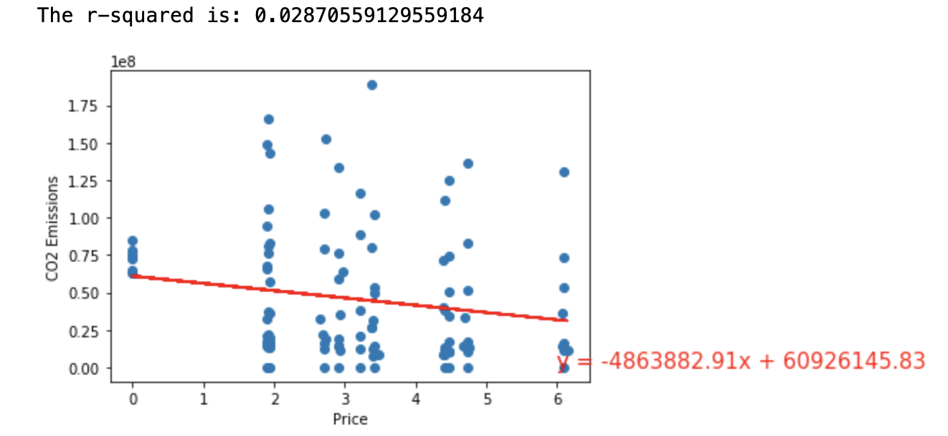
CARBON EMISSIONS vs PRICE
CARBON EMISSIONS vs PRICE
A negative relationship was found. As price ↑, emissions ↓.
Emissions decreased by 4,863,882.91 metric tons per dollar increase of the price.
The r-squared was low, at roughly 0.028, or explaining only 2.8% of the total variation.
Notes:
Noah

Slide 13
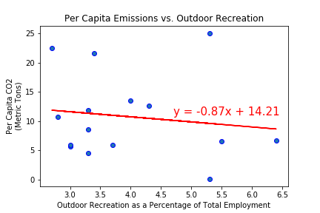
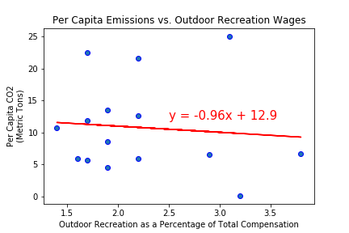
CARBON EMISSIONS vs OUTDOOR RECREATION
CARBON EMISSIONS vs OUTDOOR RECREATION
The trend is slightly negative.
The correlation is very weak.
R-squared is .0189 for total “employment”, and .0085 for total “wages”.
Notes:
Noah

Slide 14
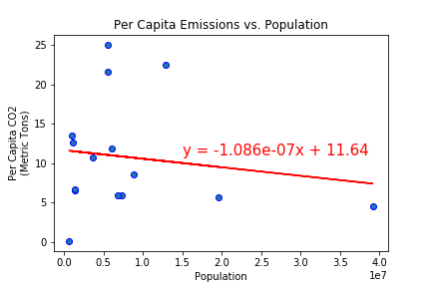
CARBON EMISSIONS vs POPULATION
CARBON EMISSIONS vs POPULATION
A negative relationship was found. As population ↑ , emissions per capita ↓.
The r-squared was low, at roughly 0.022, or explaining only 2.2% of the total variation.
Notes:
Noah

Slide 15
01
03
TOPIC, HYPOTHESES
ANALYSIS, RESULTS
02
04
DATA
CONCLUSIONS
05
FUTURE WORK

Slide 16




PROBLEM
PROBLEM VS. SOLUTION
SOLUTION
What is the relationship between carbon emissions and other variables ?
Utilizing regressions, we came to some conclusions !
Notes:
Carl

Slide 17


1ST CONCLUSION - EMISSIONS vs PRICE
1ST CONCLUSION
A negative relationship was found, in line with our hypothesis.
Only 2.8% of the variation was explained by the model.
This may be because our emissions data came from all sources, not just the electricity generation industry.
Notes:
Carl

Slide 18

2ND CONCLUSION -
EMISSIONS vs OUTDOOR SPACE
2ND CONCLUSION
The data does not support our hypothesis. The correlation is negative, but very weak.
“Outdoor Recreation” includes a broad range of activities.
There may be stronger correlations for more detailed subgroups of activities.
Notes:
Carl

Slide 19

3RD CONCLUSION - EMISSIONS vs POPULATION
3RD CONCLUSION
A negative relationship was found, in line with our hypothesis.
Only 2.2% of the variation was explained by the model.
Drilling down into more detailed aspects of populations size (e.g. population density), may yield stronger correlations.
Notes:
Carl

Slide 20
01
03
TOPIC, HYPOTHESES
ANALYSIS, RESULTS
02
04
DATA
CONCLUSIONS
05
FUTURE WORK

Slide 21
NOTES FOR FUTURE WORK
DATA
FURTHER STUDY
OTHER FACTORS
NOTES FOR FUTURE WORK
Usage of emissions data from solely electricity generation.
could be done into where resources from a price on carbon are spent;
To general fund? Green initiatives?
that influence carbon emissions;
Local laws? National standards? International treaties such as Paris?
Notes:
Jack
Further study could be done into where resources from a price on carbon are spent.
Do they go to the general fund? Or to Green initiatives? This likely varies by state.
What other factors influence carbon emissions?
Local laws? National standards? International treaties such as Paris? This would be interesting to further examine using data.

Slide 22

THANKS!
THE END
Does anyone have any questions?

